Slide 1
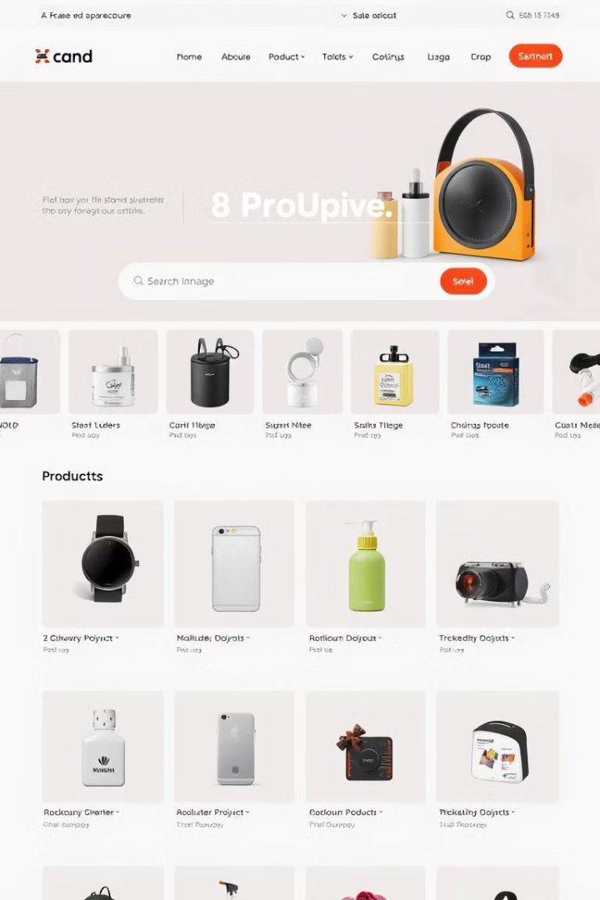
Apna Super Baazaar – A Dynamic E-Commerce Platform
Apna Super Baazaar is a multi-page, responsive online shopping website for groceries and hygiene products. Built using HTML, CSS, JavaScript, and PHP, it provides a smooth and user-friendly shopping experience.

Slide 2
Project Overview
What is Apna Super Baazaar?
Core Features
A dynamic shopping website with essential e-commerce functionalities. It ensures seamless browsing, product selection, and secure transactions.
User Authentication (Login/Register system using PHP)
Product Categories (Groceries, Hygiene, etc.)
Search & Filter Options
Add to Cart & Checkout System

Slide 3
Goals & Objectives
1
Create a secure, scalable, and user-friendly e-commerce platform.
2
Ensure a responsive design for all devices (desktop, tablet, mobile).
3
Enhance user engagement through intuitive UI/UX.
4
Build a functional and interactive shopping experience.
5
Implement smooth product searching, filtering, and checkout.
6
Integrate database connectivity for managing user and product data.

Slide 4

Sustainable Development Impact
Paperless Transactions
Local Businesses
Reduced Emissions
Promotes paperless transactions and digital shopping.
Encourages local businesses to showcase products online.
Reduces transportation emissions by enabling home deliveries.

Slide 5
Methodology (Development Process)
Planning & Design
1
Wireframing, UI/UX concepts, database structure.
2
Frontend Development
HTML, CSS, JavaScript for interactivity.
Backend Development
3
PHP for user authentication and database handling.
4
Database Integration
MySQL for storing user and product data.
Testing & Optimization
5
Ensuring smooth performance on all devices.

Slide 6
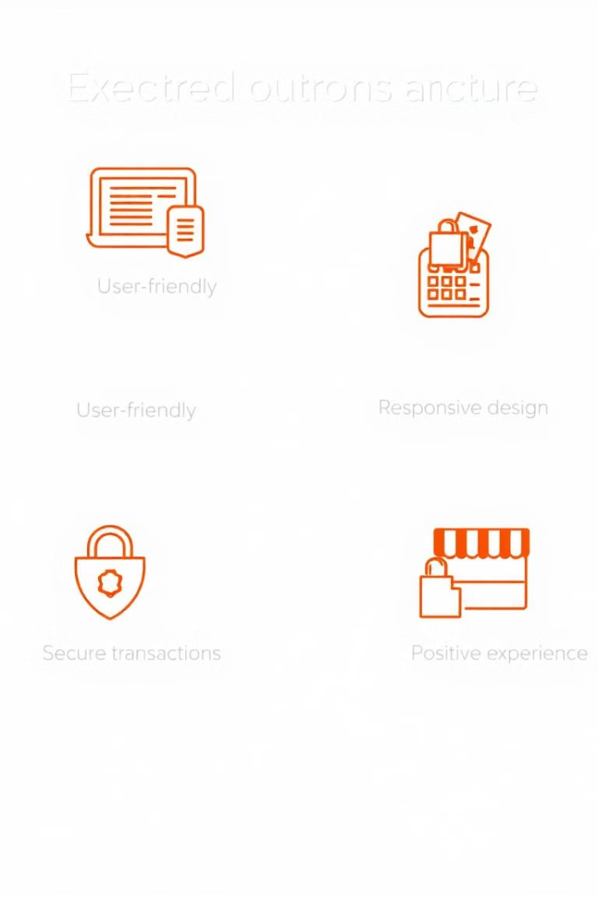




Expected Outcomes
User-Friendly Shopping Platform
Responsive & Scalable Website
Secure Transactions & Data Management
Easy navigation, secure authentication, smooth shopping experience.
Works on all screen sizes with fast loading speeds.
PHP & MySQL handle data securely.
Better Shopping Experience
Improved accessibility and convenience for users.

Slide 7





Key Project Deliverables
Fully Functional Website
With all e-commerce features.
Database System
To manage products, users, and orders.
Secure Login & Checkout System
Using PHP & JavaScript.
Well-Documented Code & Deployment Guide

Slide 8





Next Steps & Deployment Plan
Order Tracking & Delivery Status
Online Payment Integration
2
Razorpay, PayPal, etc.
1
AI-powered Product Recommendations
3
5
Deployment Process
Security & Performance Optimization
Host on a web server (e.g., AWS, Firebase, or a shared hosting service).
4

